Slide 1
Homogeneous
2D Transformation

Slide 2
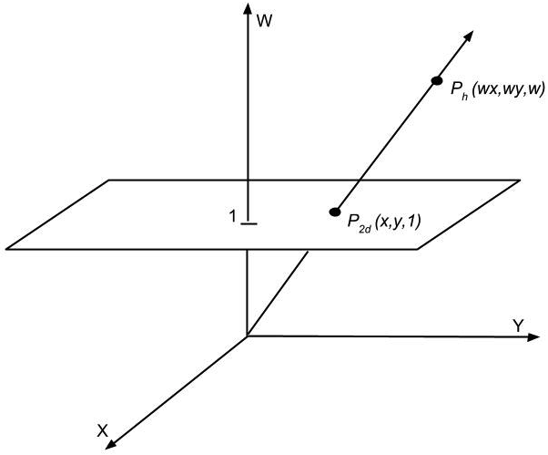
Homogeneous coordinates
Add an additional dimension, the w-axis, and an extra coordinate, the w-component
Thus, 2D -> 3D (effectively the hyperspace for embedding 2D space)
Allow expression of all three 2D transformations as 3x3 matrices
We start with the point P_{2d} on the xy plane and apply a mapping to bring it to the w-plane in the hyperspace
P_{2d}(x,y) → Ph(wx, wy, w), w≠0
The resulting (x’,y’) coordinates in our new point P_{h} are different from the original (x,y), since x’ = wx, y’ = wy
P_{h}(x’, y’, w), w ≠ 0

Slide 3
Homogeneous coordinates
The transformations we use will always map points in the hyperplane defined by w = 1 to other such points.
In other words, we want our transformations T to map points v = to points v’ =

Slide 4
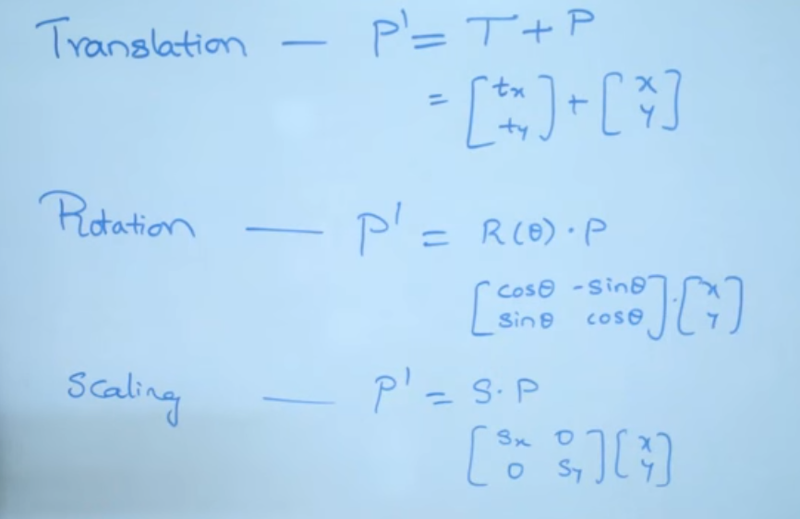
2D Transformation

Slide 5
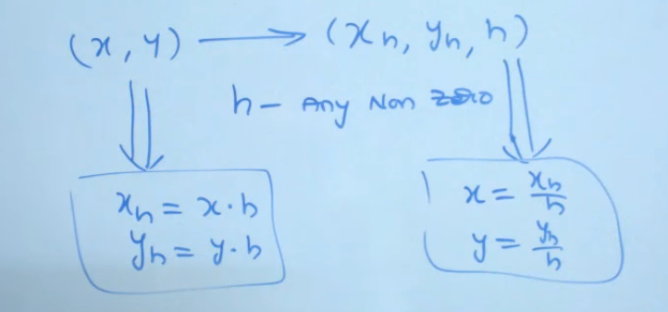
Homogenious

Slide 6
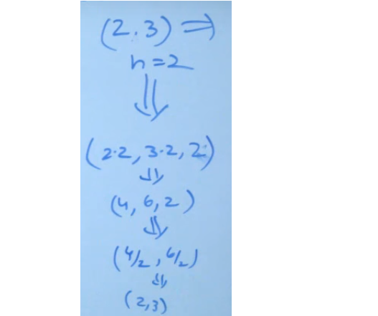
2d>3D

Slide 7
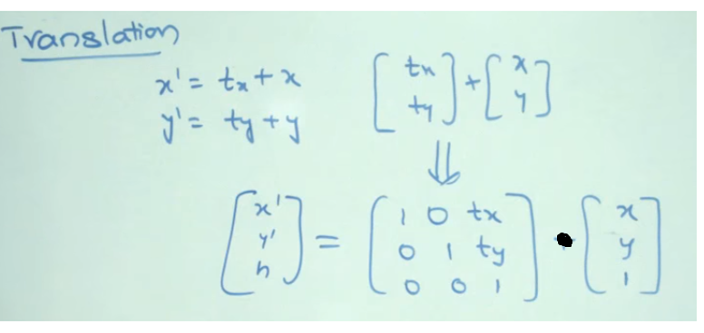
Homogeneous Translation

Slide 8
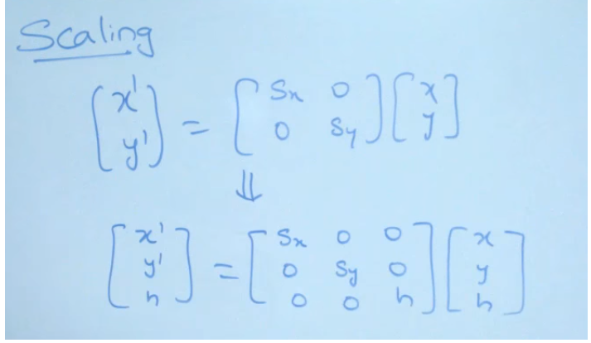
Homogeneous Scaling

Slide 9
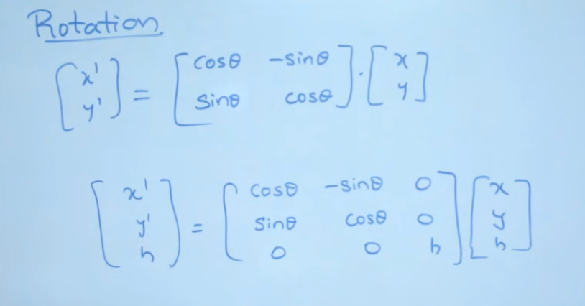
Homogeneous Rotation

Slide 11
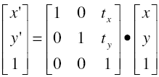

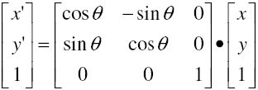
2D Transformations
2D translation matrix
P’ = T • P
2D scaling matrix
P’ = S • P
2D rotation matrix
P’ = R • P

Slide 12
Examples
Scaling: Scale by 15 in the x direction, 17 in the y
Rotation: Rotate by 123º
Translation: Translate by 2 in the x direction, 3 in the y

Slide 13
Mirror Reflection

Slide 14


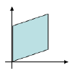
2D Transformations
2D shear
Distorts shape of objects
Transformed shape appears as if the object were composed of internal layers that had been caused to slide over each other

Slide 15
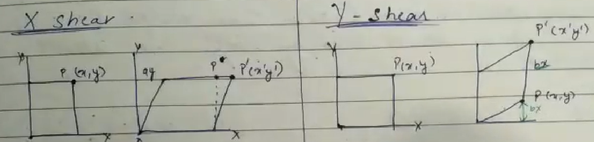
Homogeneous Shearing

Slide 16
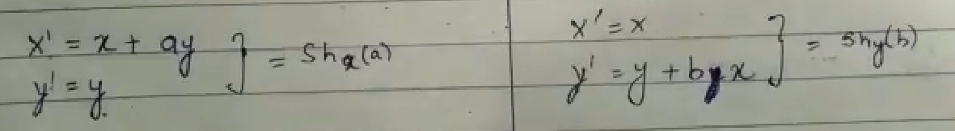

Slide 17
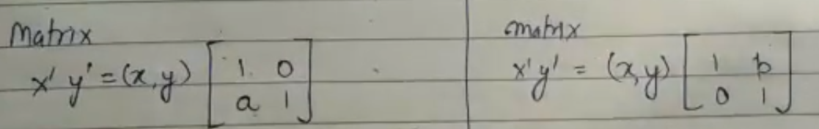

Slide 18
2D Form

Slide 19
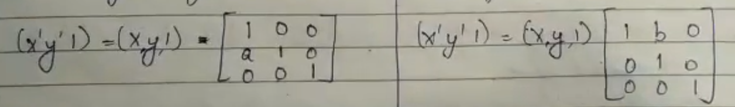
Homogeneous form

